Slide 1

Departmental Architecture Review Board
Tax Fraud Detection System (TDFS) Solution Architecture
December 3, 2024
Presenters: Roni Diwan Shilpi Dubey
Dhruv Doshi Margaret Havey
Presented for: Endorsement

Slide 2
Background
Canada’s Budget 2024 directs CRA to address tax non-compliance in real estate transactions to protect home buyers from the artificial manipulation of the real estate market that drives up the price of homes.
CRA will need to build or acquire new data sources and create new application functionality for its current application.
CRA Current State (Fictional)
Two legacy data centres enable high availability (HA), disaster recovery (DR)
Source Data stored on a mainframe
Application architecture monolithic; is becoming difficult and costly to change
Built before enterprise internet use; security controls need updating
Data centres scheduled for closure in a few years
Data profile is PBMM
Strong interest in using Cloud

Slide 3
Objective
To meet the new measures to combat tax fraud in real estate transactions as directed by Budget 2024, CRA needs to update its existing tax application and data architecture to move it from a monolithic architecture to a more modern architecture that can take advantage of the Cloud capabilities available in 2024.
Value Proposition
Implementing the Tax Fraud Detection System will benefit Canadians and Government alike.
Canadians
CRA
Government of Canada
More Canadians will be able to buy or rent a home
All taxpayers will pay their rightful share of taxes
Improved tax fraud detection and compliance
Prevention of tax avoidance through early intervention
Budget obligations met
Increased tax revenues
Advancement of Digital Government objectives
Reduction in legacy data centre technical debt

Slide 4
Happy Path
Submission
Risk Assessment
Flagging
Reports
Investigation
Notes:
Main Flow (Happy Path):
Submission: Taxpayer files tax return as usual through CRA / third party/ tax expert
Risk Assessment: Application runs risk analysis
Flagging: High-risk submissions are flagged for review.
Investigation: Analysts review flagged cases and decide on actions.
Compliance Reporting: Data is reported to stakeholders.

Slide 5
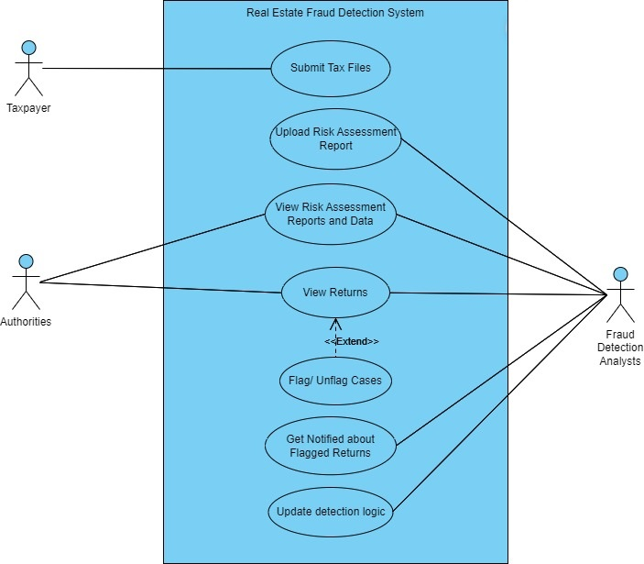
Application Key Actors & Use Cases
Notes:
Core Actors:
Taxpayer: Submits tax filings, updates property info.
Tax Authority Officer: Reviews flagged cases and takes corrective actions.
Fraud Detection Engine: Identifies suspicious behaviors using data models.
Compliance System: Monitors taxpayer filings and payments.
Key Use Cases:
Tax Filing & Submission: Taxpayer submits data.
Data Validation: System cross-checks data against external sources.
Suspicious Activity Detection: Flagging potentially fraudulent activities.
Investigation & Review: Compliance officers investigate flagged activities.
Goal: Provide alerts and workflows for investigations.

Slide 6
Application Architecture - Microservices & Data Synchronization
Microservices Architecture:
DB-Per-Service pattern - Decentralized approach with independently managed services.
Separation of concern design principle.
Core Services: Fraud detection, data validation, compliance workflows.
Benefits: Modularity, scalability, and fault isolation.
Decentralized Data Model
Data Consistency Challenge:
Eventual Consistency: Microservices may not be in sync immediately but converge over time.
Event-Driven Architecture (EDA): Enables asynchronous communication and data synchronization.
Event Examples: SuspiciousTransactionDetected , CaseResolved .
Event Handling: Use of Kafka or other message brokers for event publishing and subscription.
Notes:
Motivation for choosing MSA over Monolithic :
Strategic Value to Business : Aligns to Business Architecture composability action plan. Enable swift ROI and change process efficiency.
Separation of concerns. Address complexity and scalability requirements.
Follows composable architecture. Divides the entire system into smaller, modular services that can operate independently, focusing on specific business functions or capabilities.
Modularity practices create dynamic and deployable application and seamless data integration.

Slide 7
Application Architecture - Patterns to support Microservices Dependencies
Supporting Integration Patterns:
API Gateway: Simplifies client interactions and reduces complexity.
Saga Pattern: Manages complex workflows and compensates failures.
Circuit Breaker: Ensures fault tolerance and avoids cascading failures.
Service Discovery & Load Balancing: Efficiently routes requests to microservices.
Future Scalability: Plan for future integrations (e.g., external databases, APIs).
Key Takeaways:
A flexible, modular approach to meet scalability, fault tolerance, and fraud detection needs.
Event-driven architecture enables better handling of decentralized data and eventual consistency.
Notes:
Assemblage process is followed to develop GOOD service architechture. Key design challenge when using microservices, is implementing distributed operations, which span multiple services. Presents a challenge since each service has its own database.The solution is to use the service collaboration patterns.
API Gateway Pattern:
An API Gateway can act as a facade for clients, routing requests to the appropriate services and aggregating responses from multiple services. This is useful when multiple services need to be queried to provide a complete response to the client (e.g., collecting data from fraud detection and compliance services to present a decision). Can handle rate limiting, authentication, and logging centrally. To prevent single point of failure design it for high availability.
○ Utility:
Simplifies communication from clients by exposing a single entry point.
Allows for API composition, where the API Gateway aggregates responses from multiple services.
Saga Pattern:
The Saga pattern is designed to handle long-running transactions and coordinate workflows across multiple services. In a tax fraud detection system, a saga can help coordinate a complex flow where multiple services need to be involved in a single fraud detection process.
A saga can either be choreographed (each service knows its role and publishes events to trigger the next action) or orchestrated (a central orchestrator service directs the process flow). Use Case: If a fraudulent activity is detected in a transaction, the saga can involve various steps, such as notifying the tax authority, updating the user's account status, and creating an audit trail. If any step fails, compensating actions can be triggered to ensure consistency. Implementation:
Use event-driven communication (e.g., Kafka) to implement the saga steps and ensure eventual consistency across services.
An API Gateway will use a Circuit Breaker to invoke services.Circuit Breaker proves its utility as it prevent a network or service failure from cascading to other services.It functions in a similar fashion to an electrical circuit breaker. When the number of consecutive failures crosses a threshold, the circuit breaker trips, and for the duration of a timeout period all attempts to invoke the remote service will fail immediately. After the timeout expires the circuit breaker allows a limited number of test requests to pass through. If those requests succeed the circuit breaker resumes normal operation.
A modern microservice-based application typically runs in a virtualized or containerized environments where the number of instances of a service and their locations changes dynamically.Service Discovery pattern implements a mechanism that enables the clients of service to make requests to a dynamically changing set of transitory service instances.It solves the issue of the client of a service - the API gateway or another service - to discover the location of a service instance.

Slide 8

Security : Threat Landscape and Security Challenges
Threats Identified:
Data Breaches: Unauthorized access to taxpayer and real estate transaction records.
Insider Threats: Malicious or accidental misuse of data by authorized users.
Ransomware: Encryption of systems, jeopardizing Protected B data integrity.
DDoS Attacks: Overloading systems, leading to unavailability of services.
API Vulnerabilities: Risks of injection, session hijacking, and insecure endpoints.
Security Challenges:
Ensuring compliance with Protected B classification standards for data security.
Addressing vulnerabilities in legacy systems to modernize security.
Safeguarding integrations with external data sources while maintaining compliance.

Slide 9
Security : Core Security Controls
Access Management:
Role-Based Access Control (RBAC): Restricts data based on user roles.
Multi-Factor Authentication (MFA): Adds a second layer of verification.
Just-in-Time Access: Temporary permissions for sensitive operations.
Data Protection:
Encryption: AES-256 for data at rest, TLS 1.3 for data in transit.
Anonymization: Pseudonymizes sensitive data to protect privacy.
Network Security:
Segmentation: Divides networks into Public, Restricted, and Operations zones.
Intrusion Detection & Prevention Systems (IDS/IPS): Monitors and mitigates malicious activity.
Application Security:
OWASP compliance: Prevents vulnerabilities like SQL injection and XSS.
OAuth 2.0: Secures API access and enables rate limiting.

Slide 10
Security : Advanced Security and Risk Mitigation
Advanced Mechanisms:
Zero Trust Architecture: Continuous user and device verification with segmented access.
DevSecOps:
Security embedded in CI/CD pipelines.
Automated scans for vulnerabilities in codebases.
AI for Threat Detection: Behavioral analytics for anomalies and insider threats.
Risk Mitigation Strategies:
Incident Response Plan:
Role-specific playbooks for breaches and ransomware attacks.
Post-incident analysis to improve detection and response mechanisms.
Backup and Disaster Recovery:
Regular, encrypted backups stored across distributed locations.
Periodic recovery tests to ensure readiness in emergencies.

Slide 11
Integration Architecture Overview
Integration Goals:
Seamlessly connect internal CRA data with external sources: Integrate CRA’s internal taxpayer data with external property registries, provincial records, and other tax authorities.
Ensure real-time data flow and consistent decision-making: Enable seamless, real-time processing of data for efficient fraud detection and compliance.
Architectural Components:
Event-Driven Microservice Architecture:
Events are captured and processed in real time. When a tax return is submitted, the system triggers microservices such as Validation and Fraud Detection to process and analyze the data instantly.
API Gateway:
Acts as a central hub, managing secure communication between microservices using OAuth 2.0 for authentication and TLS encryption for data security.
Data Lakehouse:
A centralized repository for storing structured and unstructured data. It ensures that data is cleansed, transformed, and enriched before being processed, supporting scalable fraud detection and compliance monitoring.

Slide 12
Workflow - ELT +Event-Driven Microservices+ Data Lakehouse
Event stream
Event triggered when a tax return is submitted (captured by Kafka).
Event triggers microservices like Validation and Fraud Detection.
Data Processing Flow:
Event Capture: Event detected and captured in real-time.
Data Processing: Data (taxpayer info, filing data) processed, validated, and checked for anomalies.
Data Enrichment (ELT Process): Additional financial data enriched into the Data Lakehouse for deeper analysis.
Fraud Detection:
Historical Pattern Matching: Comparing data for discrepancies in income and tax liabilities.
Machine Learning Models: Models predict likelihood of fraud based on historical data.
Alert Generation:
Suspicious activity detected, generating alerts and flagging users for investigation.
ELT pipeline extract data from different data sources (internal and external), load it into data Lakehouse, transforms in compute layer by segregation of data in 3 zones (bronze, silver, gold) and loads it into decentralized storage systems for individual microservices.
Notes:
Motivation to adopt this Integration workflow :
1. Separation of Concerns:
• Microservices are focused on their core business logic (e.g., handling tax filings, detecting fraud), while the ELT pipeline focuses on data integration, transformation, and loading. This keeps both systems simpler, more maintainable, and decoupled.
2. Scalability:
• Microservices can scale independently from the ELT pipeline. For example, if system have a spike in tax filing submissions, system can scale the Tax Filing Microservice to handle more requests without affecting the ELT process.
• Similarly, system can scale the ELT pipeline to handle large amounts of data extraction, loading and transformation.
3. Real-time or Batch Processing:
• Microservices can publish data in real-time via event streams (e.g., Kafka), enabling the ELT pipeline to consume and process data in near real-time.
• Alternatively, the ELT process can run on a batch schedule (e.g., nightly), pulling data periodically from the microservices.
4. Flexibility in Data Processing:
• The ELT pipeline can transform and enrich data in a way that is independent of the microservices. For example, the microservices do not need to know about the data lakehouse or the reporting layer — they just expose data for ELT to consume.
5. Event-driven Architecture:
Instead of polling for data periodically, microservices can publish events (e.g., via Kafka), and the ELT system can subscribe to these events. This makes the entire system event-driven and more efficient, as data is only processed when there is new or updated information to process.

Slide 13
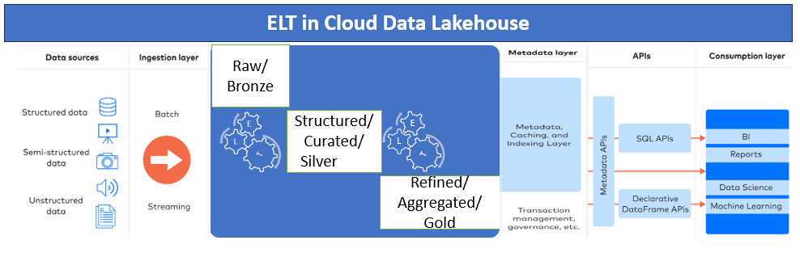
ELT in Cloude Data Lakehouse

Slide 14
Integration Benefits and Outcome
Data Flow Optimization:
ELT pipelines efficiently extract, load, and transform data, ensuring it is cleaned and enriched before being processed. This allows the system to use accurate, up-to-date data for fraud detection and analysis.
Real-Time Decision-Making:
Event-driven architecture enables the system to detect and process events like tax return submissions in real-time. This allows the fraud detection system to flag anomalies immediately, ensuring compliance officers can take timely action.
Fault Tolerance:
The decoupled microservices architecture ensures that services are isolated from each other. If one service fails, others continue to function independently, maintaining overall system stability and minimizing the risk of downtime.
Compliance:
The system is designed to meet PIPEDA and Protected B standards for secure data processing and exchange. This guarantees that sensitive data, such as taxpayer information, is securely handled and fully compliant with privacy and data protection regulations.
Scalability:
The modular integration approach allows for easy scaling of individual services as needed. This ensures the system can handle increased data volumes, such as during peak tax seasons, without compromising performance or reliability.

Slide 15
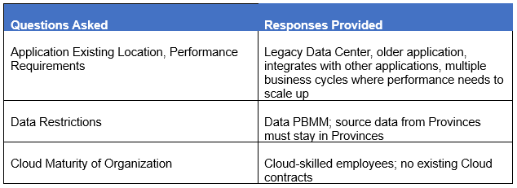
Technology Perspective
Aspects: Hosting Location, Data Storage, Application Tiers
Guidance: GC Technology Architecture Framework (updated to 2024)
Hosting Location Considerations
Decision: Hybrid Cloud for computations; On Premise for Data and Application.
Application may be able to move to the Cloud later, if that is desirable.

Slide 16
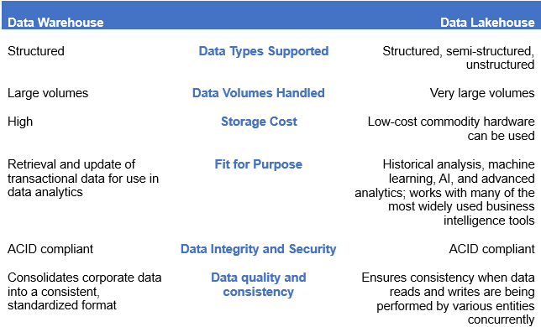
Data Storage Considerations
ACID – atomicity, consistency, isolation, and durability
Decision: Mainframe storage system will remain on-premise; a Data Lakehouse will be implemented for enabling advanced analytics.

Slide 17
Layered Technology Architecture
Data
Processing & Analytics
Security
Integration
Cloud Infrastructure
Presentation
Notes:
Title: Layered Technology Architecture
Separation of concerns – easier to manage
Flexible, adaptable, easy to maintain and expand
Six Layers of Architecture:
Data Layer: Manages ingestion and secure storage.
Processing Layer: Fraud detection engine with ML models and rules.
Security Layer: Access management, encryption, and monitoring.
Integration Layer: APIs and data sharing frameworks.
Infrastructure Layer: Hybrid cloud hosting for scalability and availability.
Presentation Layer: Case management and reporting portals for compliance officers.
Key Features:
Zero-Downtime Deployments: Ensures uninterrupted service.
CI/CD Pipelines: Supports continuous innovation and testing.
Monitoring and Resilience: Proactive detection of performance issues.

Slide 18
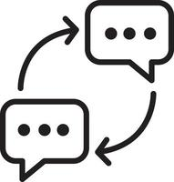

Layered Technology Architecture
Preventing Common Issues
Each layer performs a specific task​
Combination of closed and open layers ​
Caching
Event-driven architecture
Encapsulation
Dependency injection (DI), Inversion of control containers (IoC), software design patterns
Architecture Sinkhole Antipattern
Tight Coupling

Slide 19
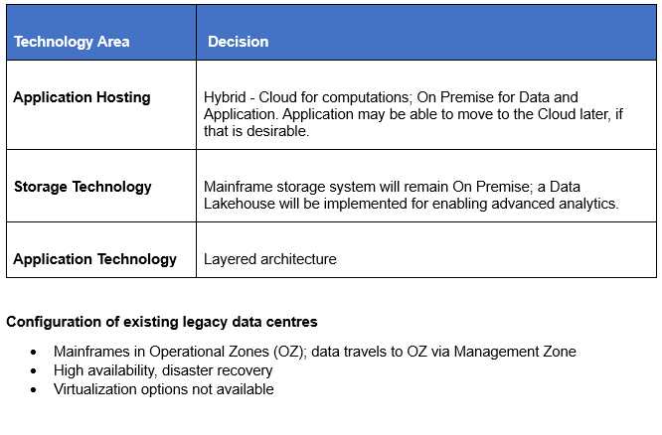
Summary of Technology Decisions

Slide 20
TFDS Implementation Roadmap
Migrate Data From Data Warehouse to Data Lakehouse (18-24 months)
Discovery and Assessment
Detailed Architecture, Workload Migration Plan
Id initial use case, design patterns, test move use case workload to Prod, validate
Begin phased migration, validation cycle will both platforms running in //
Decommission
part/all of Data Warehouse
Create New Application Functionality using Microservices and Layered Architecture (18-24 months)
Identify app functionality to move to microservices
Decompose into components, define interfaces
Select programming languages, orchestration tools
Set up infrastructure
Start implementation , data management, define integration patterns , test
Test and Deploy
* The Data Lakehouse and modernized application functionality can be completed in parallel
Move computational aspects to the Cloud – Data Lakehouse, New Application must be in Production first (6-12 months)
Use SSC Cloud Broker service to identify Cloud requirements and Cloud Service Provider (CSP)
Obtain contract to ensure data will never reside in the Cloud
Select CSP services for Data Integration
Configure/Implement Data Integration
Test and Deploy

Slide 21

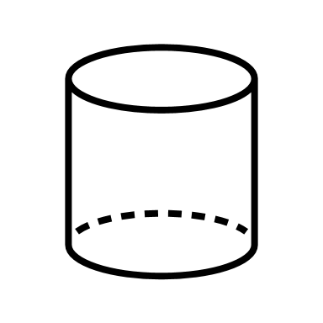


Appendix A
Tax Fraud Detection System
Cloud Connection Pattern for Service and Application Interoperability
For PaaS (Hybrid IT – Internet, application layer connection)
Secure Cloud to Ground (SC2G) service incorporated
CSP
Dept
SaaS
EIS/IIS
GC-managed Gateway
CSP
GC Backbone
PaaS
Hybrid Cloud
Based on GC Cloud Connections Patterns
May not be exact
Legacy DC

Slide 22
References
OWASP Foundation. (n.d.). OWASP Top Ten Security Risks. Retrieved from https://owasp.org/www-project-top-ten/
Government of Canada. (n.d.). Baseline Security Requirements for Network Security Zones (ITSG-22). Retrieved from https://www.cyber.gc.ca/en/guidance/network-security-zoning-design-considerations-placement-services-within-zones-itsg-38
Gartner. (2021). Analytics for Fraud Prevention and Detection. Retrieved from https://www.gartner.com/
The Open Group. (n.d.). Zero Trust Security Architecture. Retrieved from https://pubs.opengroup.org/togaf-standard/architecture/zero-trust.html
Government of Canada. (n.d.). Enterprise Architecture Framework. Retrieved from https://www.canada.ca/en/government/system/digital-government/policies-standards/government-canada-enterprise-architecture-framework.html
O'Reilly Media. (n.d.). Software Architecture Patterns. Retrieved from https://www.oreilly.com/library/view/software-architecture-patterns/9781491971437/ch01.html
Microsoft Architectural Pattern https://microservices.io/patterns/microservices.html
Microservices Guide https://martinfowler.com/microservices/
Data Lake houses : Everything You Need To Know https://www.splunk.com/en_us/blog/learn/data-lakehouses.html
Advanced Analytics in Taxation Fraud Detection https://www.gartner.com/document/4019576?ref=hp-wylo
Government of Canada. Budget 2024. Fairness for every generation. Retrieved October 8, 2024. From Budget 2024
Government of Canada, Treasury Board of Canada Secretariat and Shared Services Canada. 2024 Application Hosting Strategy. Retrieved November 10, 2024. From 2024 Application Hosting Strategy - Canada.ca Supersedes Cloud Adoption Strategy: 2023 Update.
Medium. Data Warehouses vs. Data Lakes vs Data Lakehouses. Retrieved November 24, 2024 from Data Warehouse vs. Data Lake vs. Data Lakehouse: Key Pros & Cons
Geeks for Geeks. (2024). Steps to Migrate From Monolithic to Microservices Architecture. Retrieved from https://www.geeksforgeeks.org/steps-to-migrate-from-monolithic-to-microservices-architecture/

